Slide 1
Chapter 2 The Business Vision & Mission
Strategic Management: Concepts & Cases
13th Edition
Fred David
Copyright © 2011 Pearson Education, Inc.
Publishing as Prentice Hall
Ch 2 -‹#›
Notes:
‹#›

Slide 2

Vision
“What do we want to become?”
https://www.youtube.com/watch?v=VlsgVmj616o
Copyright © 2011 Pearson Education, Inc.
Publishing as Prentice Hall
Ch 2 -‹#›
Notes:
‹#›

Slide 3
Vision Statement Examples
General Motors’ vision is to be the world leader in transportation products and related services.
Copyright © 2011 Pearson Education, Inc.
Publishing as Prentice Hall
Ch 2 -‹#›
Notes:
‹#›

Slide 4
Vision
Clear Business Vision
Comprehensive Mission Statement
Copyright © 2011 Pearson Education, Inc.
Publishing as Prentice Hall
Ch 2 -‹#›
Notes:
‹#›

Slide 5

Mission Statement
Answers the question:
“What is our business?”
Copyright © 2011 Pearson Education, Inc.
Publishing as Prentice Hall
Ch 2 -‹#›
Notes:
‹#›

Slide 6
Mission Statement
An enduring statement of purpose that distinguishes one organization from other similar enterprises
A declaration of an organization’s “reason for being”
Copyright © 2011 Pearson Education, Inc.
Publishing as Prentice Hall
Ch 2 -‹#›
Notes:
‹#›

Slide 7
Mission Statements are also called
Creed statement
Statement of purpose
Statement of philosophy
Statement of beliefs
Statement of business principles
A statement “defining our business”
Copyright © 2011 Pearson Education, Inc.
Publishing as Prentice Hall
Ch 2 -‹#›

Slide 8
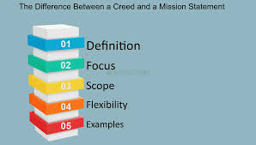
Mission Statements are also called
A company's business creed, or mission statement, is its commitment to achieve a particular goal, behave in a certain way or abide by a fundamental principle. A creed also might be a public definition of a company's guiding strategy.
Copyright © 2011 Pearson Education, Inc.
Publishing as Prentice Hall
Ch 2 -‹#›

Slide 9
Mission Statement Examples
Proctor & Gamble provides branded products and services of superior quality and value that improve the lives of the world’s consumers. As a result, consumers reward us with industry leadership in sales, profit, and value creation, allowing our people, our shareholders, and the communities in which we live and work to prosper.
Copyright © 2011 Pearson Education, Inc.
Publishing as Prentice Hall
Ch 2 -‹#›
Notes:
‹#›

Slide 10
Vision & Mission
Great benefits can be achieved if an organization
Systematically revisits their vision and mission statement
Treats them as living documents
Considers them to be an integral part of the firm’s culture
Copyright © 2011 Pearson Education, Inc.
Publishing as Prentice Hall
Ch 2 -‹#›

Slide 11

Vision & Mission
Shared vision creates a community of interests
Copyright © 2011 Pearson Education, Inc.
Publishing as Prentice Hall
Ch 2 -‹#›
Notes:
‹#›

Slide 12
Developing Vision & Mission
Participation by as many managers as possible is important in developing the mission because through involvement people become committed to an organization
Copyright © 2011 Pearson Education, Inc.
Publishing as Prentice Hall
Ch 2 -‹#›
Notes:
‹#›

Slide 13
Steps to Developing Vision & Mission Statements
Have managers read related articles
Have managers prepare a vision and mission statement for the organization
Merge the documents into one and distribute
Gather feedback from managers
Meet to revise the final document
Copyright © 2011 Pearson Education, Inc.
Publishing as Prentice Hall
Ch 2 -‹#›

Slide 14
Benefits of Mission Statements
Better financial results
Unanimity of purpose
Resource allocation
Establishment of culture
Focal point for individuals
Establishment of work structure
Basis of assessment and control
Resolution of divergent views
Copyright © 2011 Pearson Education, Inc.
Publishing as Prentice Hall
Ch 2 -‹#›

Slide 15
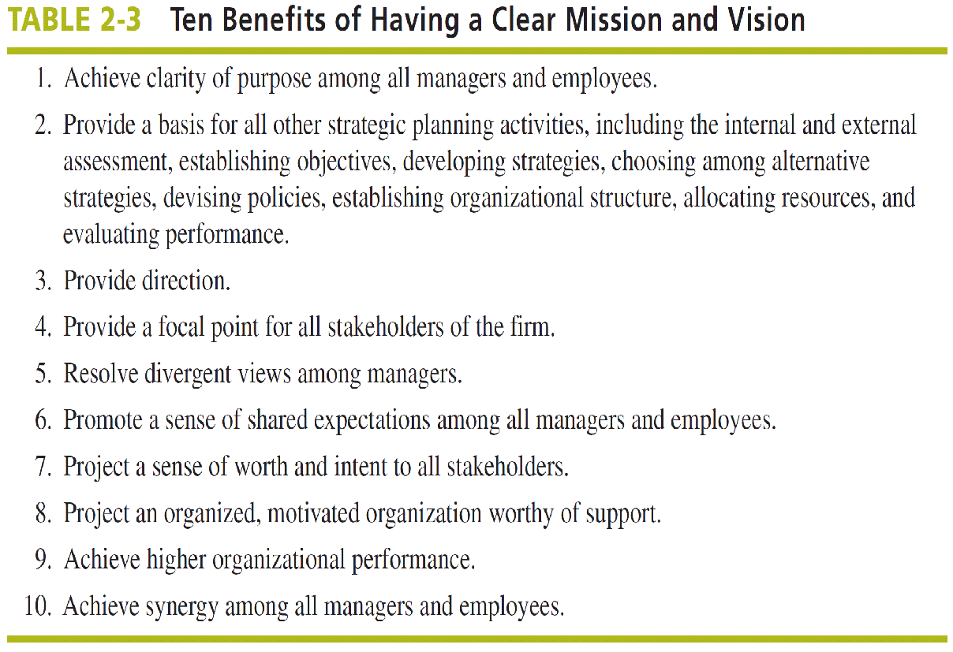
Copyright © 2011 Pearson Education, Inc.
Publishing as Prentice Hall
Ch 2 -‹#›

Slide 16
Vision & Mission Statements
Provide unity of direction
Promote shared expectations
Consolidate values
Project a sense of worth and intent
Affirm the company’s commitment to responsible action
Copyright © 2011 Pearson Education, Inc.
Publishing as Prentice Hall
Ch 2 -‹#›

Slide 17
Mission & Customer Orientation
An effective mission statement:
Anticipates customer needs
Identifies customer needs
Provides product/service to satisfy needs
Identifies the utility of a firm’s products to its customers
Copyright © 2011 Pearson Education, Inc.
Publishing as Prentice Hall
Ch 2 -‹#›

Slide 18
Products or Services
Markets
Customers
Mission Components
Technology
Employees
Survival,
Growth,
Profits
Public
Image
Self-Concept
Philosophy
Copyright © 2011 Pearson Education, Inc.
Publishing as Prentice Hall
Ch 2 -‹#›
Notes:
‹#›

Slide 19
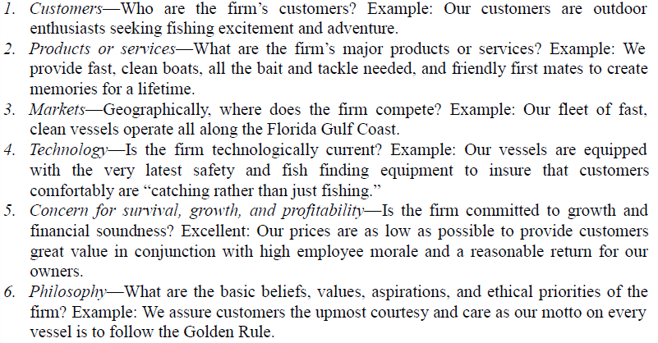
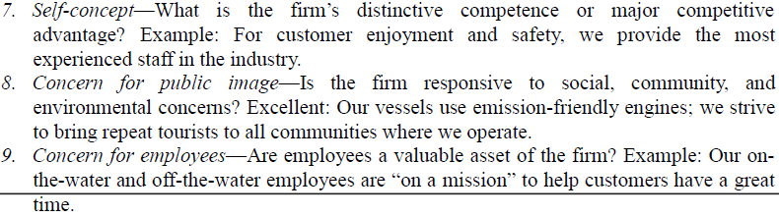
Nine customer perspective components
Copyright © 2011 Pearson Education, Inc.
Publishing as Prentice Hall
Ch 2 -‹#›

Slide 20
Nine customer perspective components
Copyright © 2011 Pearson Education, Inc.
Publishing as Prentice Hall
Ch 2 -‹#›

Slide 21
A critique of existing statements
ROYAL CARIBBEAN CRUISES LTD.
We always provide service with a friendly greeting and a smile.(7) We anticipate the needs of our customers. We make all efforts to exceed our customers’ expectations. We take ownership of any problem that is brought to our attention. We engage in conduct that enhances our corporate reputation and employee morale.(9) We are committed to act in the highest ethical manner and respect the rights and dignity of others.(6) We are loyal to Royal Caribbean and Celebrity and strive for continuous improvement in everything we do.
from http://www.rclcorporate.com/investors/overview/mission-and-vision/
Copyright © 2011 Pearson Education, Inc.
Publishing as Prentice Hall
Ch 2 -‹#›

Slide 22
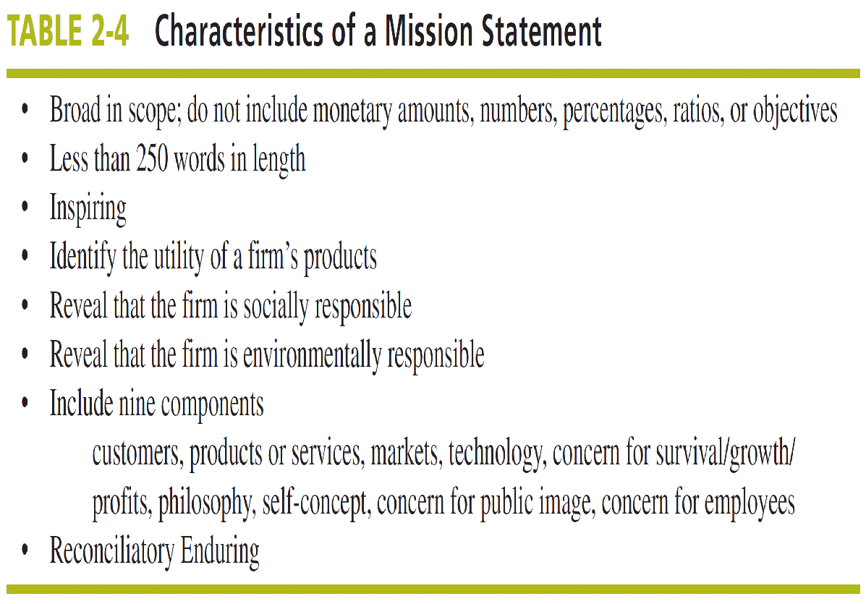
Copyright © 2011 Pearson Education, Inc.
Publishing as Prentice Hall
Ch 2 -‹#›

Slide 23
We aspire to make PepsiCo the world’s premier consumer products company, focused on convenient foods and beverages. We seek to produce healthy financial rewards for investors awe provide opportunities for growth and enrichment to our employees, our business partners and the communities in which we operate. And in everything we do, we strive to act with honesty, openness, fairness and integrity.
Copyright © 2011 Pearson Education, Inc.
Publishing as Prentice Hall
Ch 2 -‹#›

Slide 24
Dell’s mission is to be the most successful computer company in the world at delivering the best customer experience in markets we serve. In doing so, Dell will meet consumer expectations of highest quality; leading technology; competitive pricing; individual and company accountability; best-in-class service and support; flexible customization capability; superior corporate citizenship; financial stability
Copyright © 2011 Pearson Education, Inc.
Publishing as Prentice Hall
Ch 2 -‹#›

Slide 25
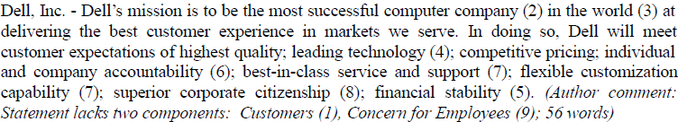
Copyright © 2011 Pearson Education, Inc.
Publishing as Prentice Hall
Ch 2 -‹#›

